Slide 1
Iterating through A Dataframe
Methods – Speed – Coding Level – Do’s – Don’ts

Slide 2
Iterrows
And why not to use it☹

Slide 3

Iterrows
Pandas has a built in function called iterrows that allows you to iterate through a data frame.
Iterrows() is used to iterate over a pandas Data frame rows in the form of (index, series) pair. This function iterates over the data frame column, it will return a tuple with the column name and content in form of series

Slide 4
Why Iterate?
Iterating is useful when you want to create a calculation between multiple columns in a dataframe.

Slide 5
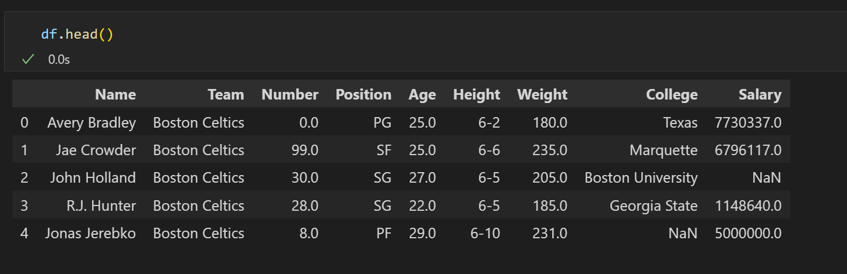
Our Dataframe

Slide 6
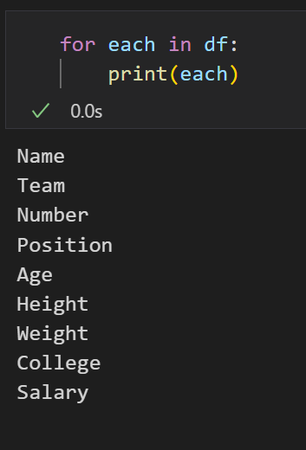
Loop
If you were to simply iterate over the dataframe using a for loop, it would give you access only the columns, as below:

Slide 7
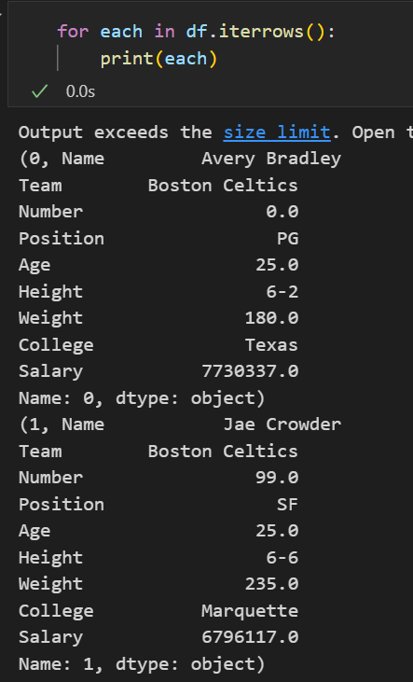
Iterrows
Iterrows() treats a data frame like a list of dictionaries and returns each row as a tuple consisting of index, row(as Pandas Series).

Slide 8
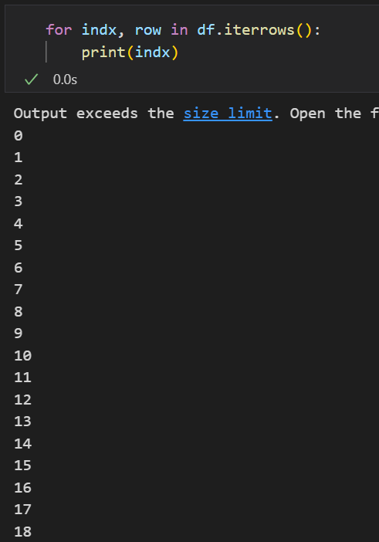
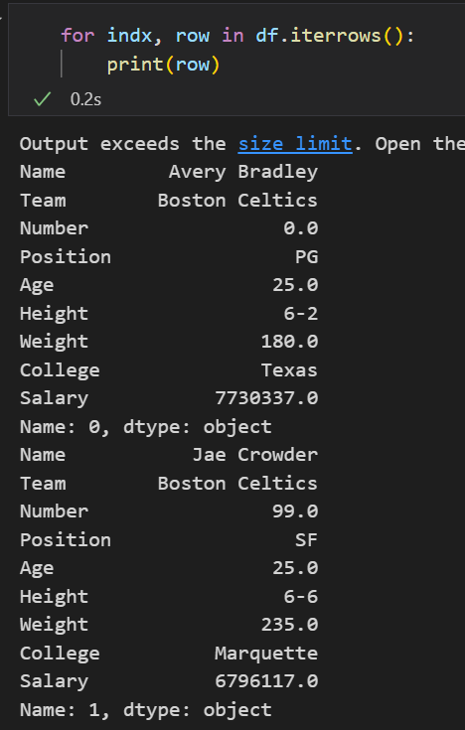
Iterrows
We use two variables to split this tuple. Observe the two variables individually in action.
Indx returns our indexes, but row returns the actual data frame values with column names.

Slide 9
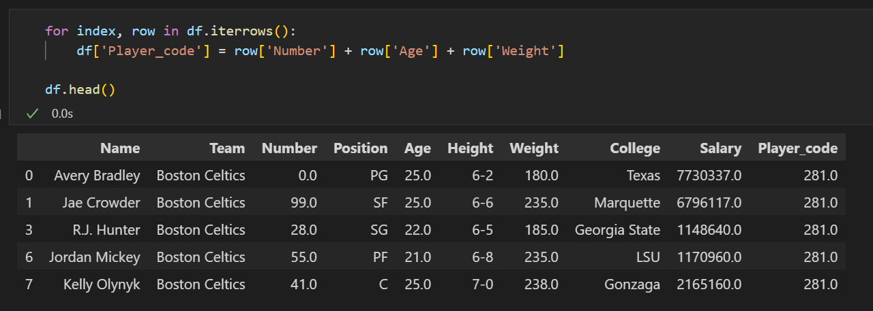
In Practice
Let’s create a unique identity code for each player using his number, age and weight. We will add a column ‘Player_code’ with the code

Slide 10
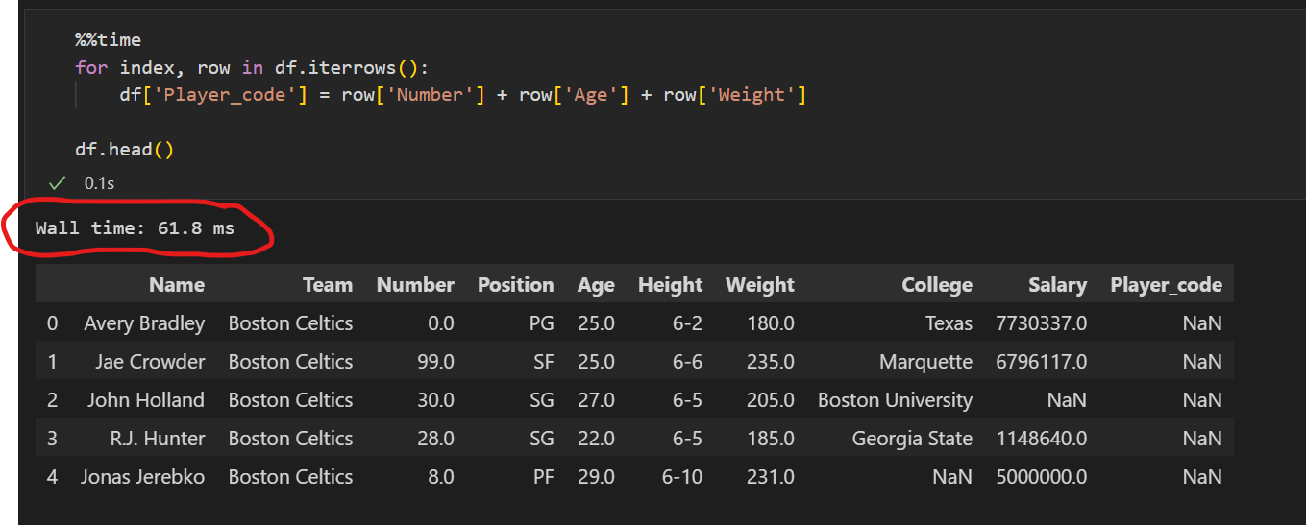
❌❌ Iterrows
Iterrows should usually be avoided as its performance is very slow compared to other iteration techniques.

Slide 11
Alternatives to iterating through a Pandas dataframe
Loc / iloc – Apply – List Comprehensions – Pandas Vectorization

Slide 12
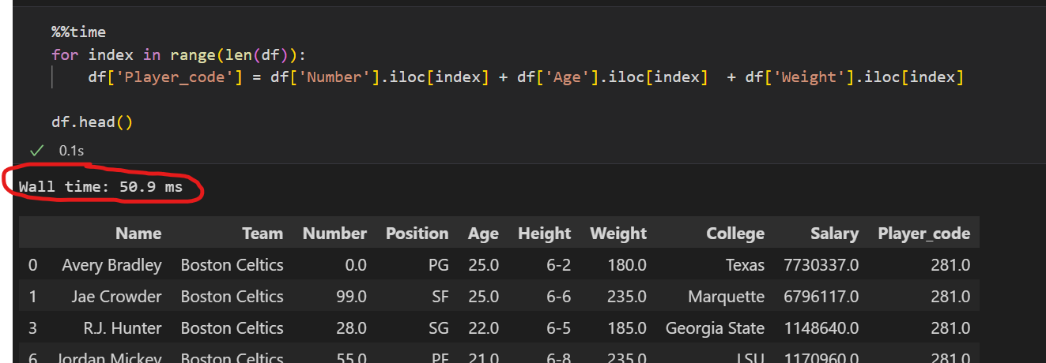
❌ For loop with .loc or .iloc (3× faster)*
As with the previous method, rows are converted into Pandas Series objects, which degrades performance.
* When running on a dataset with 22k rows

Slide 13
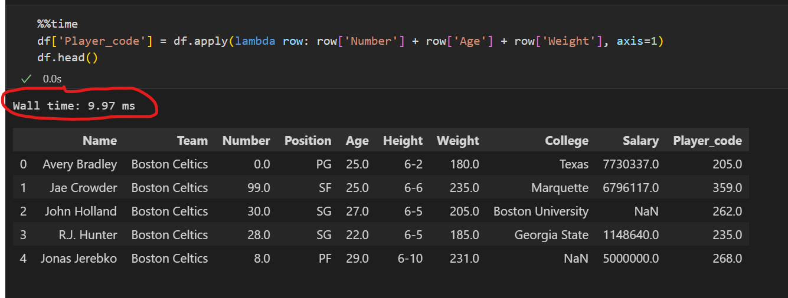
❌ Apply (4× faster)*
This method creates code that is easy to understand but at a cost: performance is nearly as bad as the previous for loop.
Don’t forget: Appy() is a great method for other applications!
* When running on a dataset with 22k rows

Slide 14
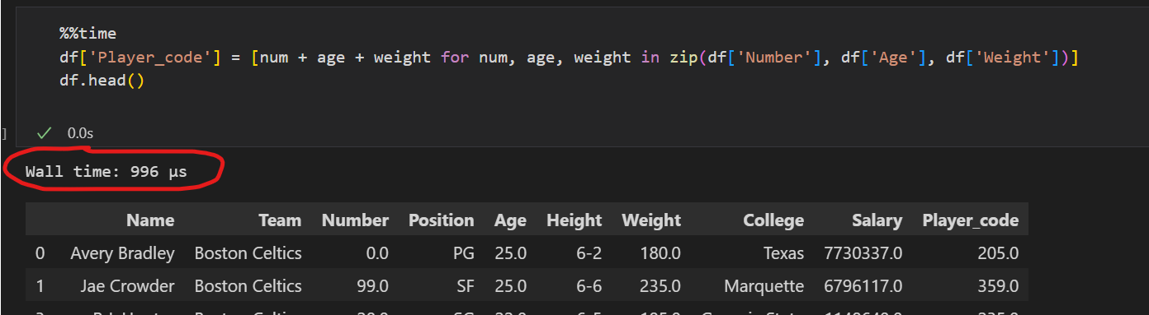
❌ ✅ List comprehensions (200× faster)*
List comprehensions are a fancy way to iterate over a list as a one-liner. It is super fast but we can keep the coding faster
* When running on a dataset with 22k rows

Slide 15
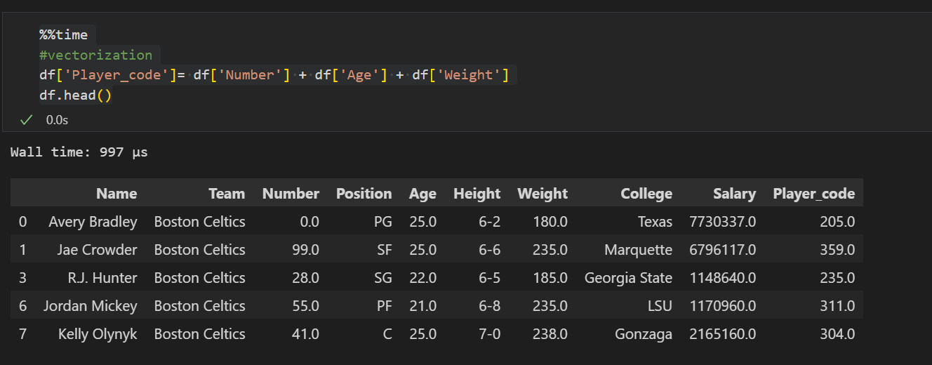
✅ Pandas vectorization (>200 × faster)*
List comprehensions are a fancy way to iterate over a list as a one-liner. It is faster but we can still do better.
* When running on a dataset with 22k rows

